Slide 1
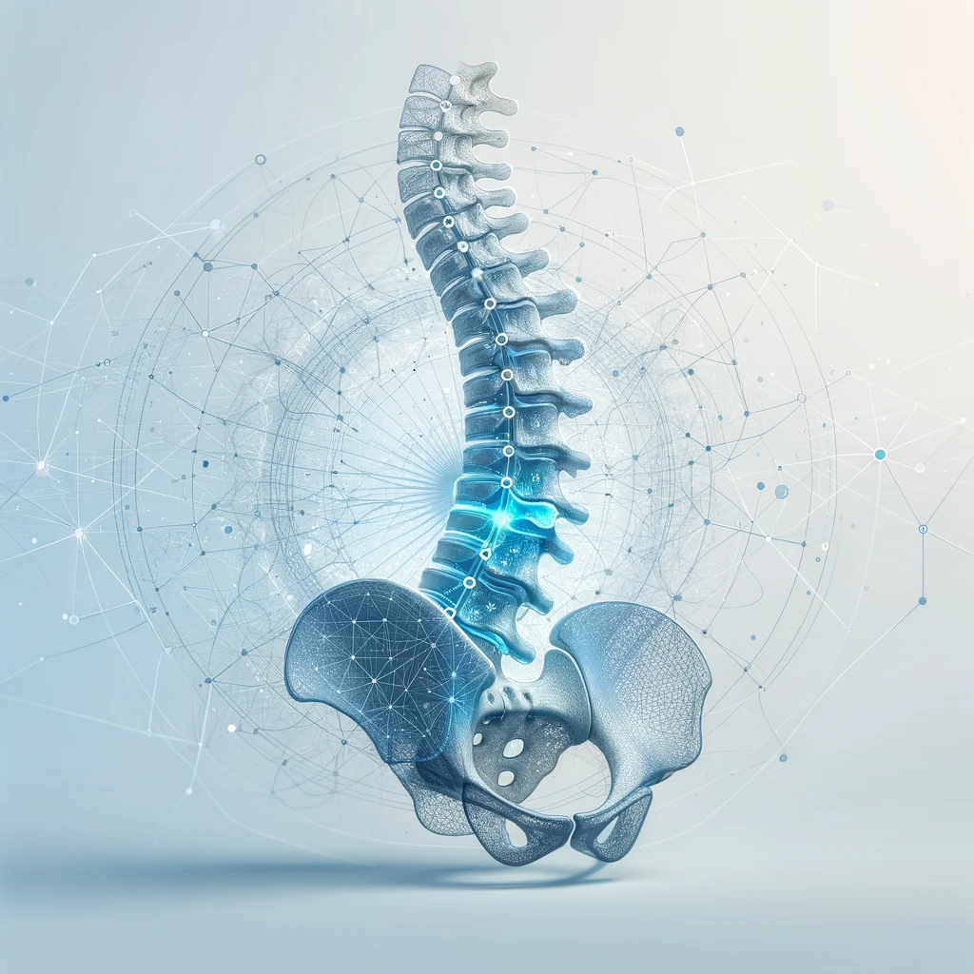
Deep Learning for Lumbar Spine Diagnosis
Contributor
Ayush Tripathi
Contributor
Arjun Ashok
Contributor
Zhian Li
Notes:
Add new images, example of interpretation maybe?

Slide 2
Background
Outline
Dataset
Architectures
Results
Conclusion
01
02
03
04
05

Slide 3
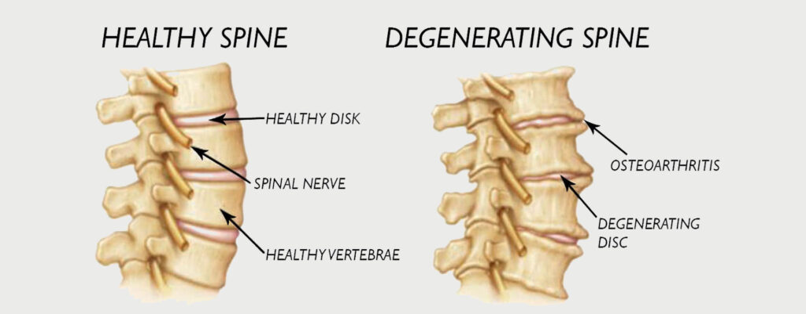
Background
Problem:
Degenerative spine conditions adversely affect people’s quality of life.
Detecting these conditions is crucial for determining therapeutic plans for patients.

Slide 4
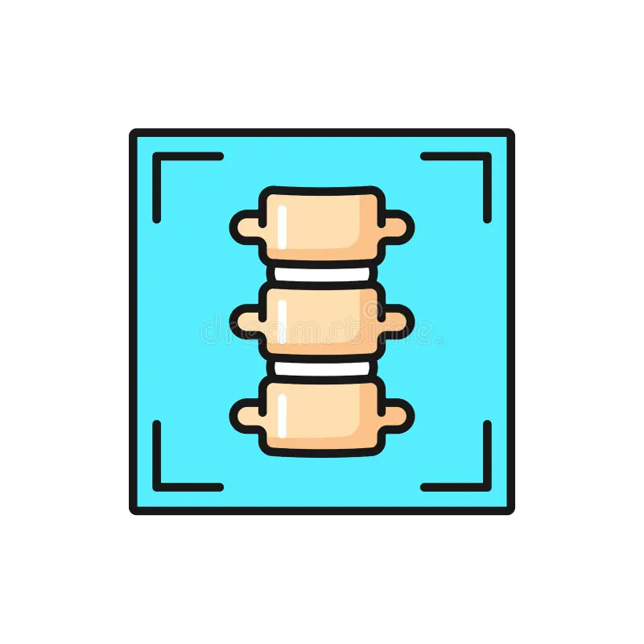

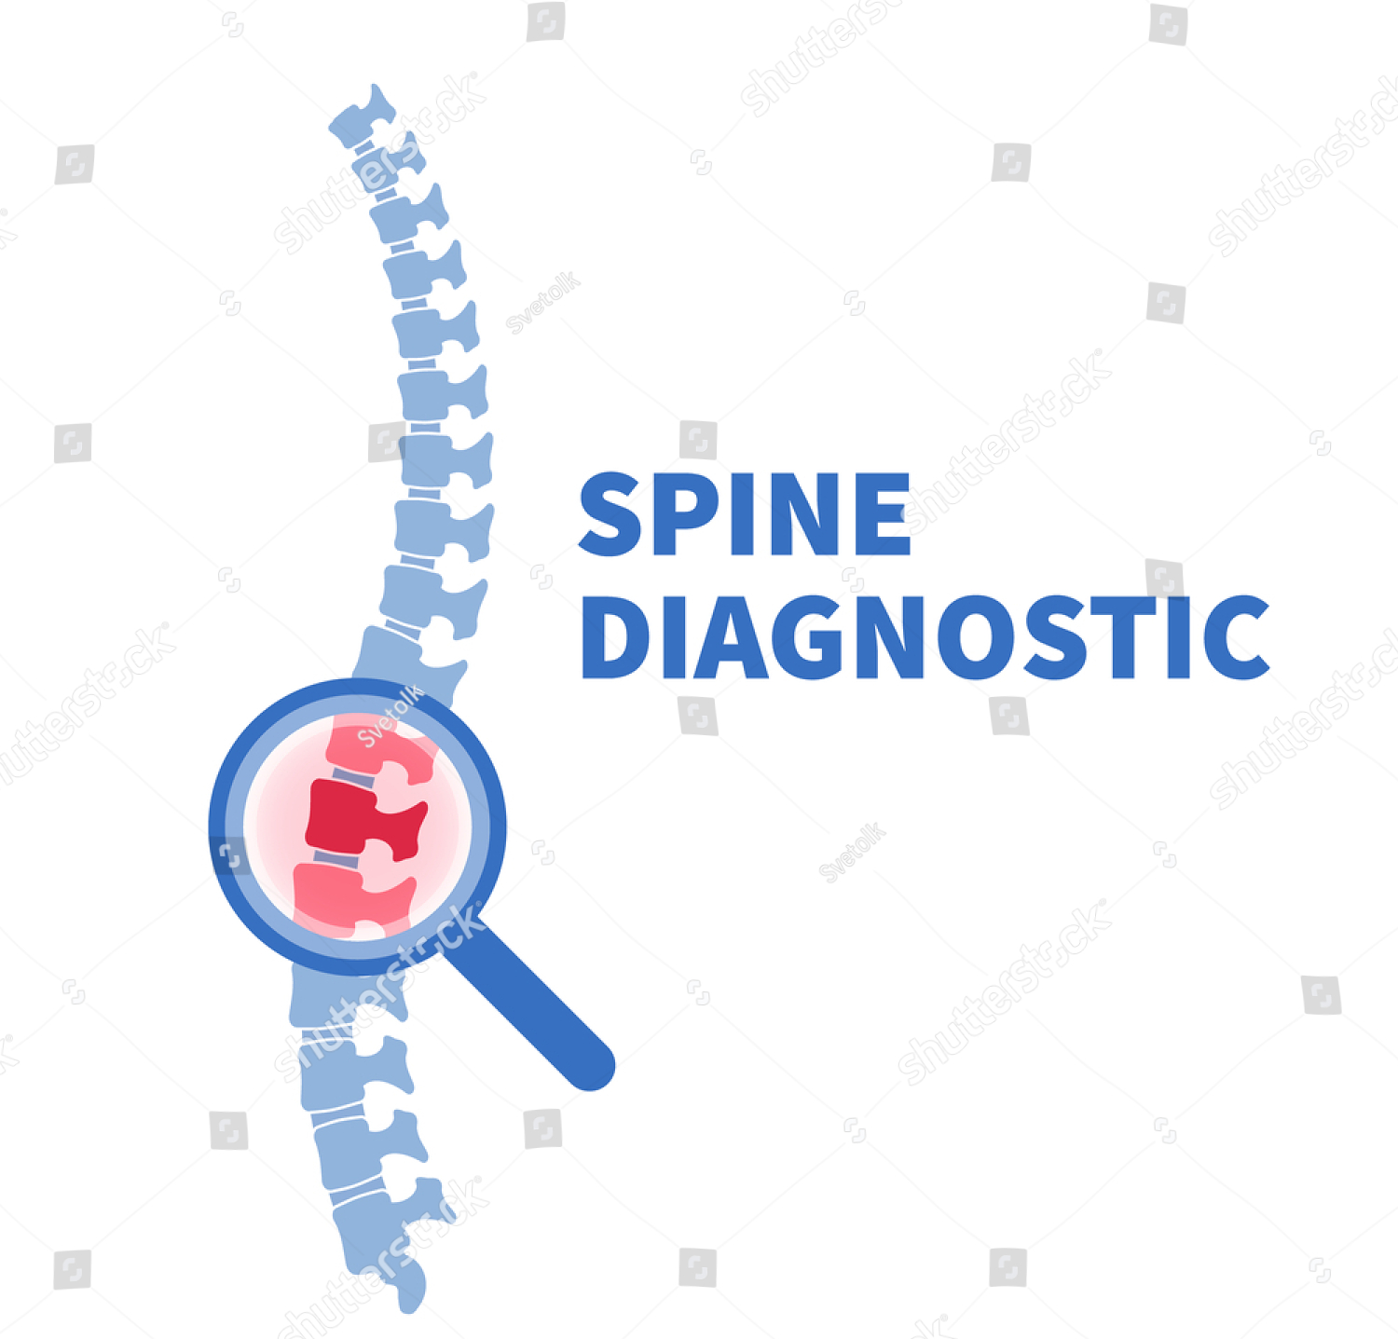
Background
Motivation:
Modern computer vision (CV) models demonstrate high accuracy in image classification
These models have the potential to assist in repetitive diagnostic tasks, such as assessing spinal conditions, providing a supporting opinion for diagnosticians
Input: Medical images (spinal CT/MRI)
Processing: CV model analyzing the image
Output: severity assessment

Slide 5
Background
Prior Work:
Mostly stems from RSNA Kaggle Competition
Previous models achieved limited success
Weighted Log-Loss: 0.36
Related studies focus on core design of individual model architectures

Slide 6
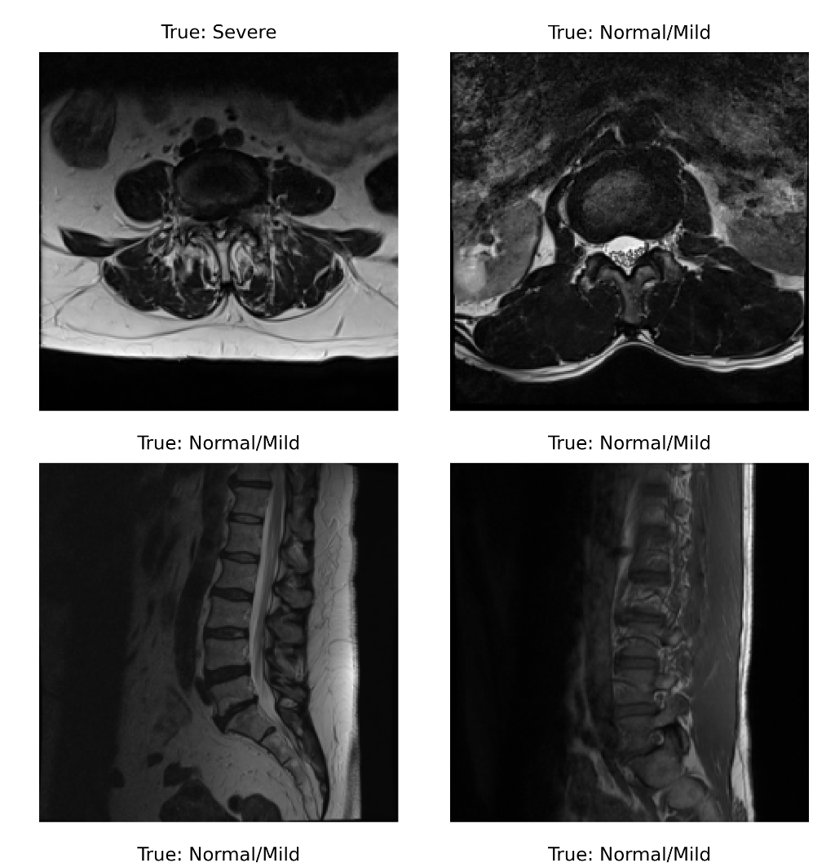
Dataset
Source
Kaggle Competition
Anatomy & Image Visualization Overview-RSNA RAIDS
Transforms Used
Resize to 224 x 224
Normalize Pixel brightness mean to 0.5, standard deviation to 0.5
Unprocessed Samples of the Dataset

Slide 7
Model Architectures
Convolutional Neural Network (CNN)
3 blocks (Conv, ReLU, MaxPool)
1 classification head, 3 linear layers (ReLU, SoftMax)
Vision Transformer
Patch Embedding (grid + projection via convolution)
Positional Encoding (learn spatial relationships)
Encoder Layers (multi-headed attention, feed-forward)
Classifier Head (CLS token)
Modified CNN (MCNN)
3 blocks (Conv, GeLU, LayerNorm MaxPool)
1 classification head, 3 linear layers (ReLU, SoftMax)
Kolmogorov-Arnold Network
3 blocks (Conv, GeLU, LayerNorm, MaxPool)
1 linear layer to project from convolutional layer
2 Spline-linear layers (KAN) for classification head
Residual Neural Network (ResNet)
ResNet-18 (18 layers deep)
Not pre-trained for fair comparison

Slide 8
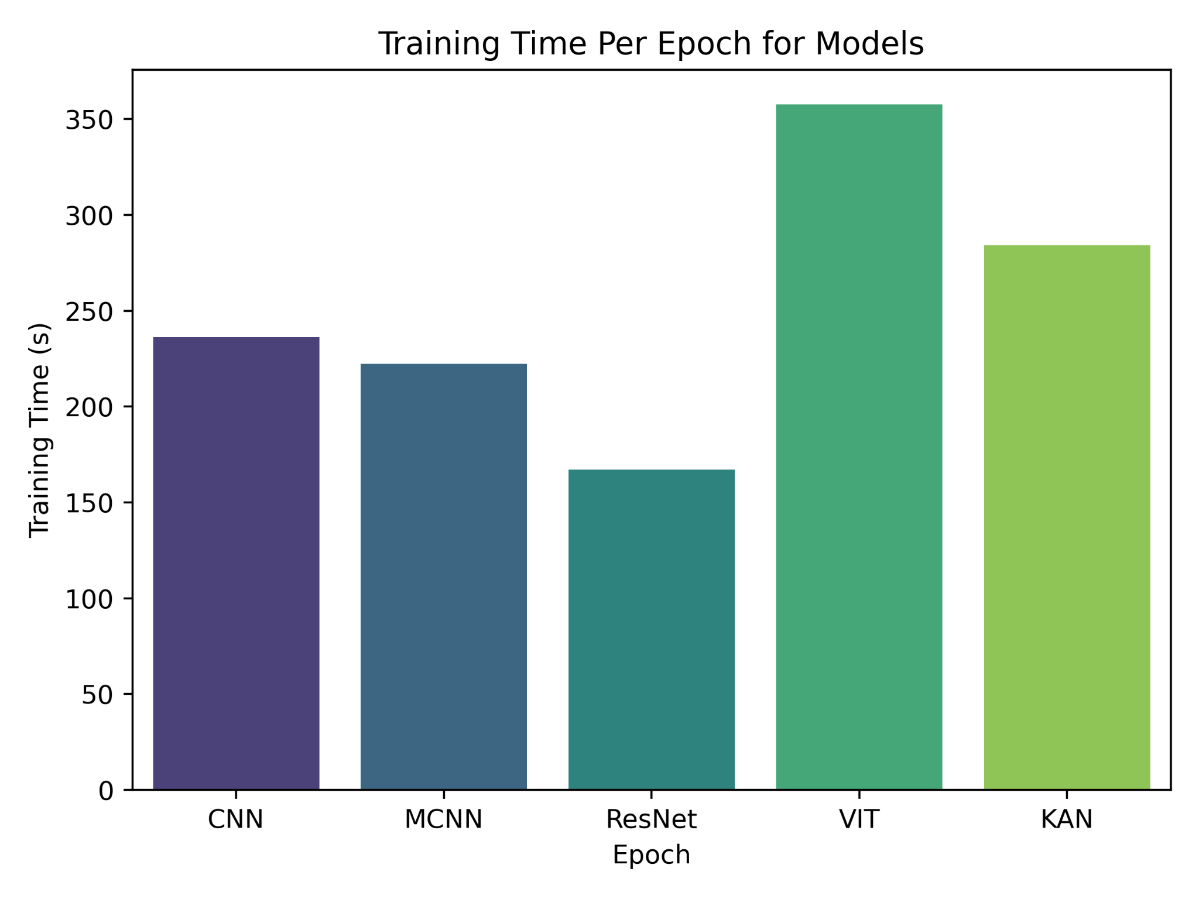
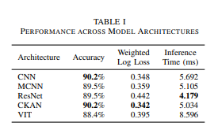
Results
Computational Efficiency
Training times similar across models, except Vision Transformer (~50% longer/epoch).
Higher computational cost due to larger architecture.
Performance
All models achieved similar accuracy
CKAN and MCNN excelled; VIT underperformed compared to ResNet despite lower WLL.
ResNet was confidently wrong, while VIT showed uncertainty in incorrect predictions.
Their larger architectures struggled with the smaller dataset; pre-training may improve results.
All models meet real-time deployment criteria, exceeding MRI framerate reqs.(≤40ms/frame).
Training Time per Epoch
Cumulative Performance Table

Slide 9
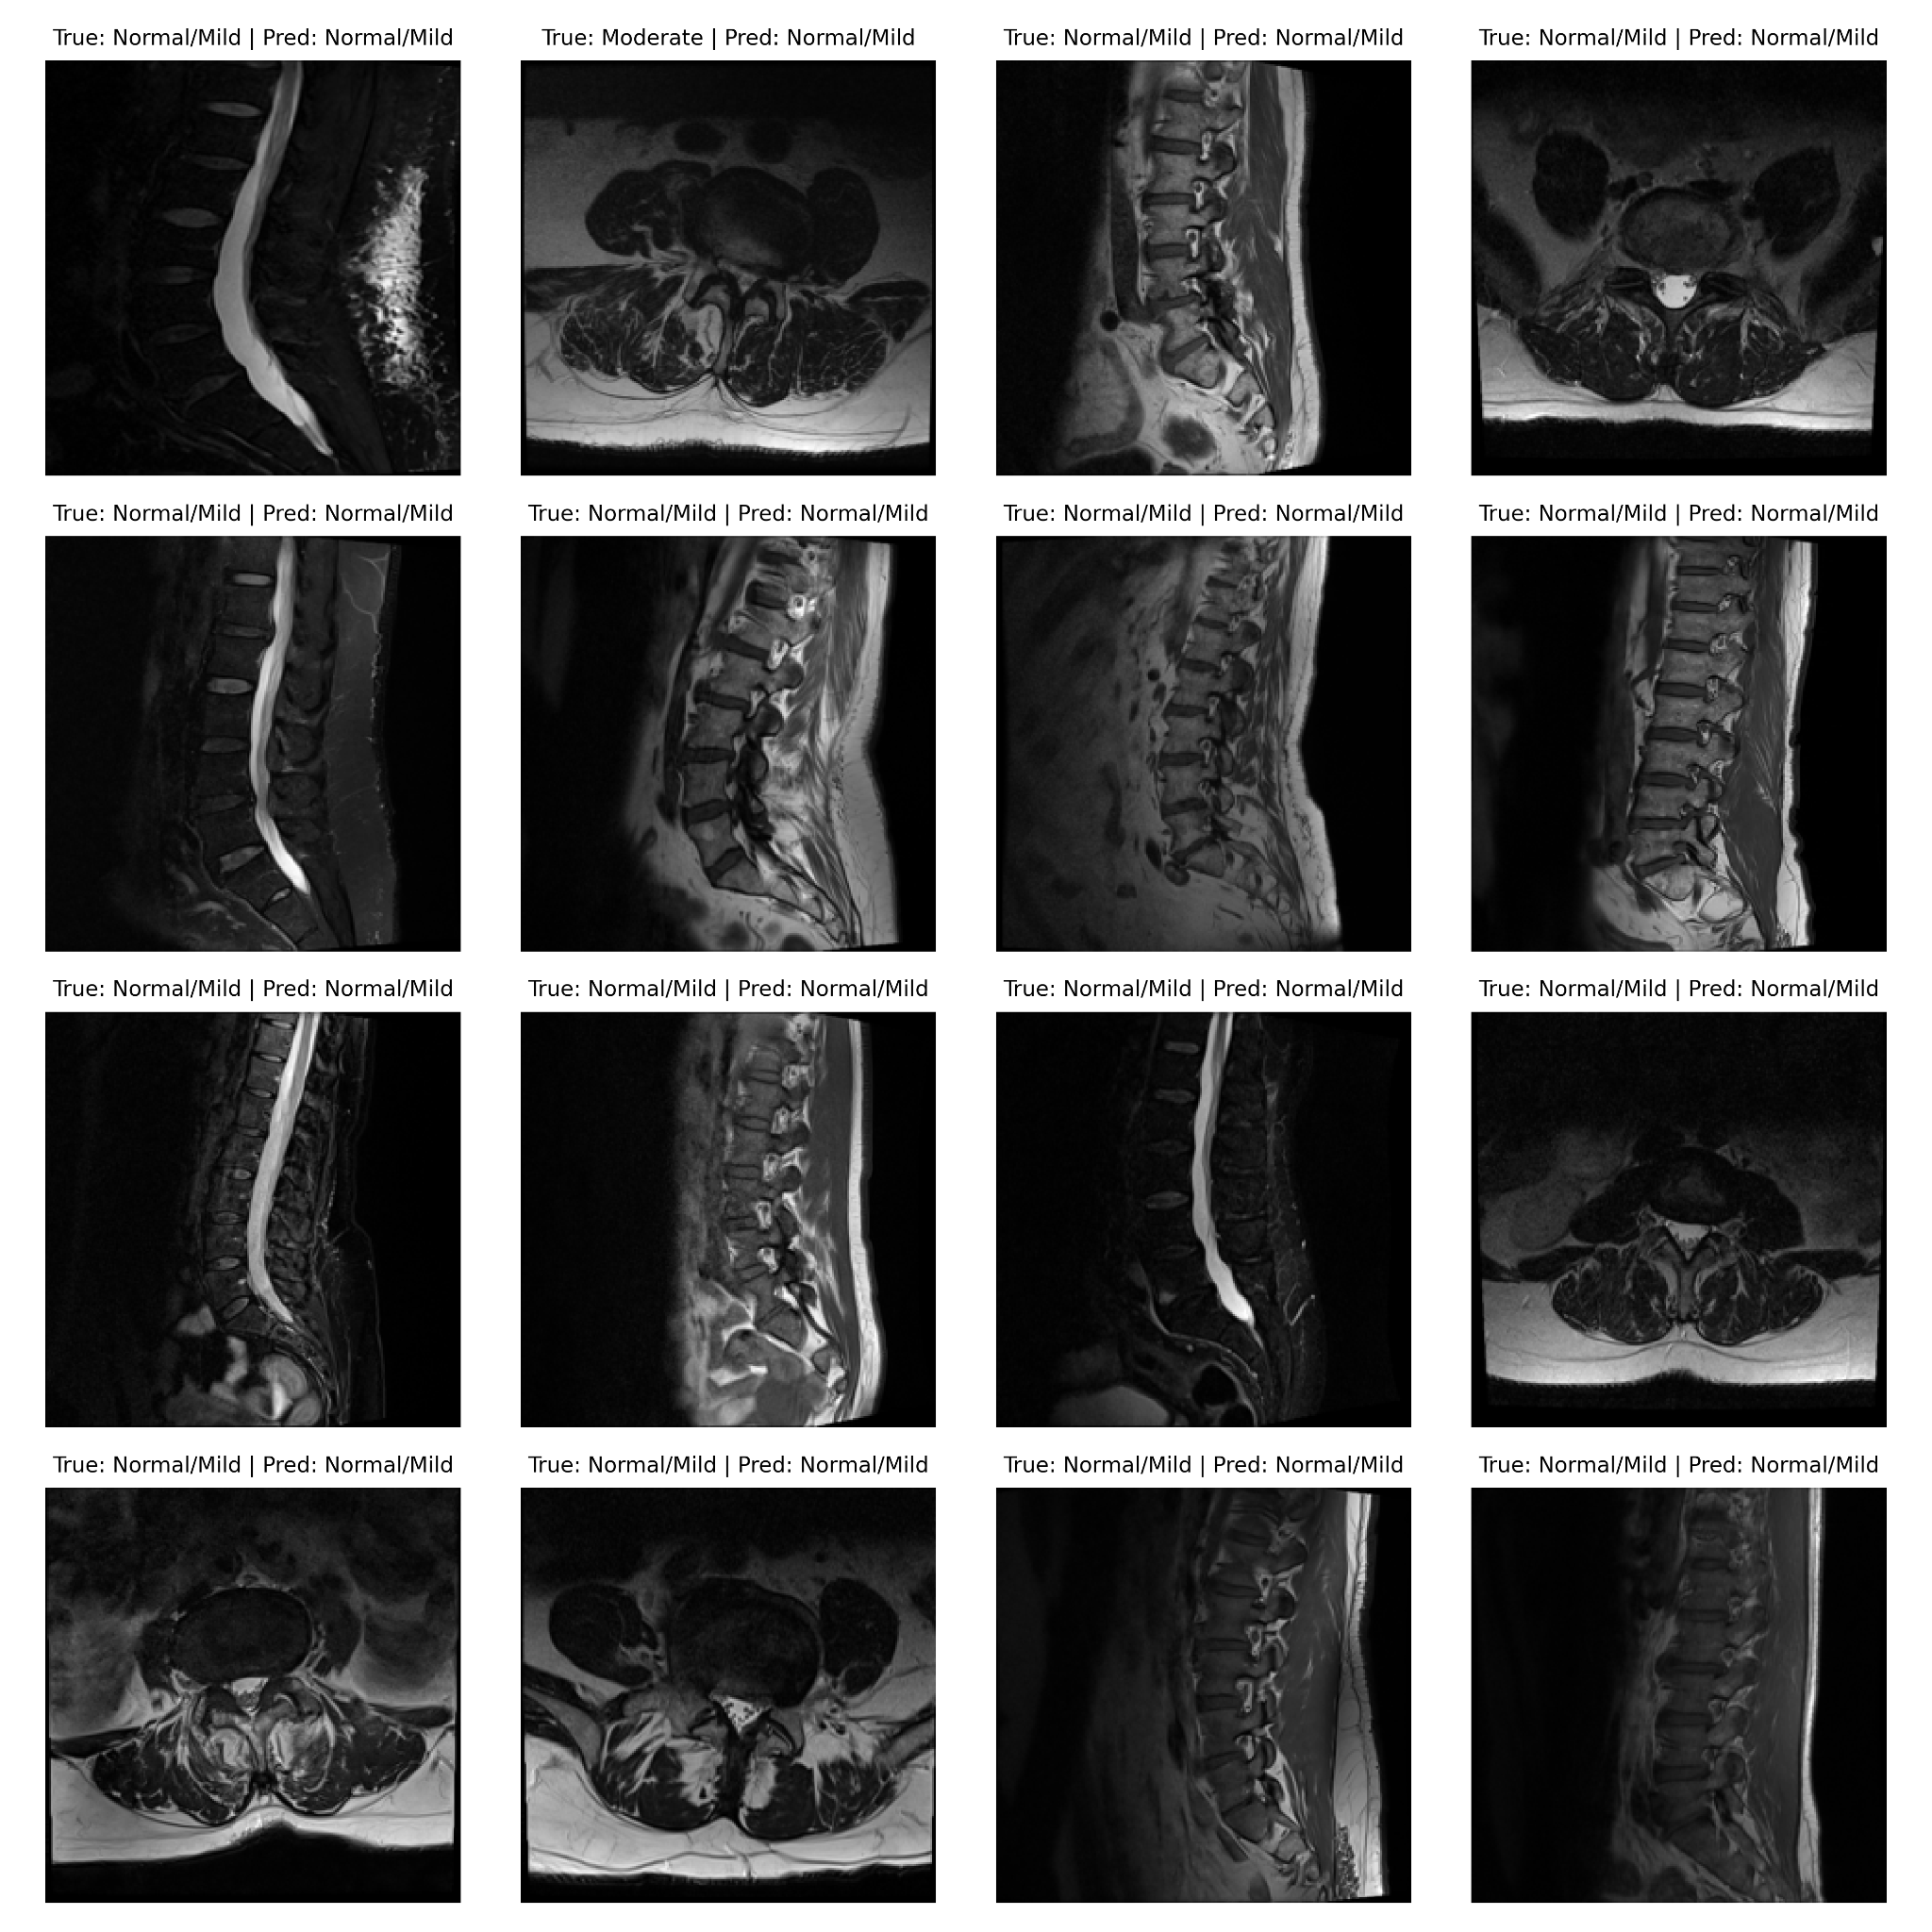
Results
Processed Samples - Predicted With CKAN

Slide 10
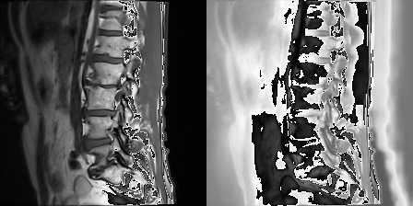
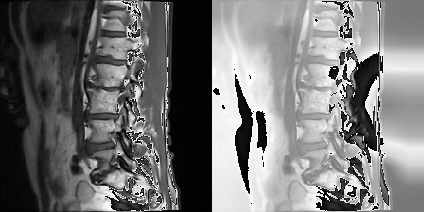
Results
CNN Interpretation
Model Interpretation
Used Grad-Cam to visualize high-activation areas as heatmaps.
CNN showed broader activations, suggesting less specific learning.
ResNet misfocused on irrelevant regions, needing more training or data.
CKAN focused on spinal fluid build-up, indicating strong localization.
‘
M-CNN seems similar to this, however CKAN has broader activations.
ResNet Interpretation

Slide 11
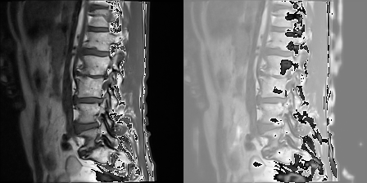
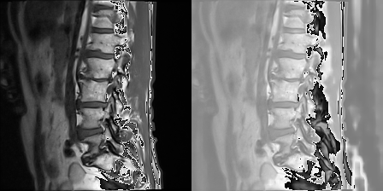
Results
CKAN Interpretation
Model Interpretation
Used Grad-Cam to visualize high-activation areas as heatmaps.
CNN showed broader activations, suggesting less specific learning.
ResNet misfocused on irrelevant regions, needing more training or data.
CKAN focused on spinal fluid build-up, indicating strong localization.
‘
M-CNN seems similar to this, however CKAN does better at finding areas of interest.
M-CNN Interpretation

Slide 12
Conclusions
Lessons
KAN demonstrates real-world efficacy for replacing MLPs
Larger models (ResNet, VIT) require more data, favoring pre-training or smaller architectures for limited datasets
Smaller CNN-based models offer better interpretability and faster inference, crucial for medical applications
Future work should explore pre-training on related/unrelated datasets and pseudo-tasks for performance boosts
Threats to validity primarily from the imbalance dataset, though we weight our loss to compensate

